Slide 1
Leveling the Playing Field Distributional Tensions and Consequences for the Social Contract in Europe
Maurizio Bussolo
The World Bank
Public Goods, Commodification and Rising Inequality
Organized by: David Grusky, Stanford University and Ravi Kanbur, Cornell University
2-3 November, 2017

Slide 2
Motivation
Inequality and distribution have been, for some time, back at the center stage of academic, policy, and institutional debates:
“I would like to use this occasion to give further impetus to the re-incorporation of income distribution into the main body of economic analysis”
Atkinson’s Presidential Address to the Royal Economic Society, 1997
Switzerland Referendum on UBI (Universal Basic Income) in summer 2016, and now pilots in many different countries.
Income inequality – in levels and (recent) trends – does not seem to be a problem for most countries in Europe and Central Asia.
Consider the EU convergence (machine); or the statistics of growth of the B40;
However, perceptions of inequality indicate that it is worsening;
This study focuses on:
Horizontal (rather than vertical) distributional tensions [positive analysis]
And proposes building blocks to renew the social contract [policy dialogue]
Notes:
One could also discuss here the context of lower growth (and more insecurity) that make a given level of inequality more salient than in an earlier period.

Slide 3
Key questions
What are the main distributional tensions in Europe and Central Asia (ECA)?
Are the current redistribution (and social protection) systems effective in countering emerging distributional tensions?
Are these emerging distributional tensions contributing to fissures in the social contract?

Slide 4
Intro: Distribution and Social Contract

Slide 5
Distribution and Social Contract
According to Rodrik (1999), well-functioning social contracts allow countries to manage shocks well and adapt to new efficient equilibria. Conversely, countries that are unable to properly manage distributional conflict often experience collapses in growth in response to shocks. This narrative highlights the centrality of the distributional conflicts and how unresolved ones lead to inefficient outcomes
The adaptation (or lack thereof) of countries to distributional conflict can be viewed as a special case of Hirschman’s (1958) depiction of development, where imbalances are happening continuously over time. The process of development is constantly reallocating resources, conferring new de facto power to actors, and shifting norms over time (WDR, 2017). How distributional tensions are processed matter for economic performance (outcome game), as well as affect formulation of the social contract (rules game)—where compliance with the rules can be understood as an equilibrium.
Notes:
How do we link the idea of the social contract (which is a broad one) to the inequality (distribution) theme?
In this slide we present some approaches from the literature on development; but there are other approaches. One could be the idea of fairness, which is measured by the inequality of opportunity approach, rather than by the inequality of outcomes… [add in the above slide something from Damien survey]

Slide 6
Distribution and Social Contract
A stable social contract is achieved when there is an ‘equilibrium’ involving:
Distribution of resources generated by market forces, with different levels of inequality, poverty, and intergenerational mobility in different economies;
Public redistribution and social protection against risks; three main mechanisms:
Redistribution via tax and transfers; or
Pre-distribution:
Pre-market: skills, health, [public goods], inheritance;
In-market: regulation of labor market, corporate governance, financial policy
Social preferences for equity-redistribution, which are the complex product of beliefs, perceptions, social values and social norms;

Slide 7
Distributional tensions

Slide 8
Distributional tensions
Standard measurements (vertical inequality) do not show increasing inequality
Alternative measures, however, provide a different picture:
Horizontal inequality: different groups are affected differently
Labor market transformations (polarization)
Inequality of Opportunity (fairness)

Slide 9
Inequality: recent evolution in ECA
Source: World Bank data from household surveys

Slide 10
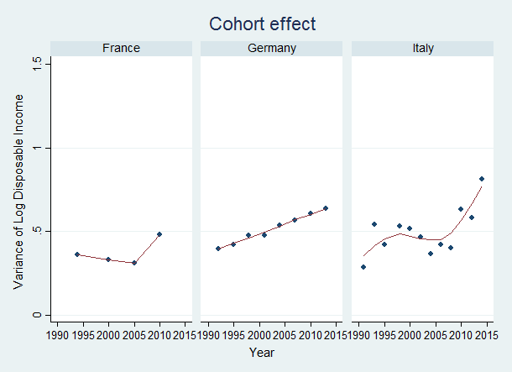
Horizontal inequality across birth cohorts
A non trivial cohort effect: cohorts born more recently are experiencing higher inequality of incomes than cohorts born in earlier years
Italy
Cohort | Gini coefficient | Equivalent to:
1930-35 | 0.319 | Japan
1945-50 | 0.329 | France
1960-65 | 0.380 | UK
1980-84 | 0.486 | Chile
Note: Calculations using a Deaton-Paxson cohort-age-time decomposition regression, and assuming log-normality
Source: Bussolo, Jappelli, Nistico and Torre (forthcoming background paper)
Notes:
Cohort effect measured for different birth cohorts at age 24-35 in the different surveys

Slide 11
Labor Market transformations (1)
Job (Occupations) polarization in the West; decrease in high skill occupations in the East
“Hollowing out of the middle class”, “Security”
“Aspirations”
Source: Bussolo, Torre and Winkler (forthcoming background paper)
Notes:
Definition of occupation categories is inspired in Acemoglu and Autor (2011) and Manning and Solomon (2007) (“Lousy jobs, lovely jobs”). Occupations (at 2-digit ISCO classification) are ordered according to their values of RTI (Routine Task Intensity). The top third is classified as Routine intensive occupations (orange bars). The remaining two thirds are ordered according to the value of the Non Routine, Cognitive task index (from O*Net). The top half of these remaining occupations are classified as Non Routine, Cognitive intensive occupations (grey bar) and the other half as Non Routine, Manual intensive occupations (Blue bar).
Changes in absolute numbers: Germany (+0.8 M for Non Routine, Manual; -2.0 M for Routine; +3.5 M for Non Routine, Cognitive), Poland (+1.5 M for Non Routine, Manual; -2.5 M for Routine; +2.0M for Non Routine, Cognitive), Spain (+1.7 M for Non Routine, Manual; +0.5 M for Routine; +2.6 M for Non Routine, Cognitive) //// Georgia (+41K for Non Routine, Manual, +15K for Routine, -7K for Non Routine, Cognitive), Kyrgyz Rep. (+243K for Non Routine, Manual, +74K for Routine, +13K for Non Routine, Cognitive), Russia (-0.3M for Non Routine, Manual, +1.1M for Routine, -1.9M for Non Routine, Cognitive), Turkey (+2.9M for Non Routine, Manual, +2.0M for Routine, +1.3M for Non Routine, Cognitive)
[Add parallel literature with MENA]
Examples of occupations in each category:
Non-Routine, Manual: Personal and protective services workers (51), Sales and services elementary occupations (91), Drivers and mobile-plant operators (83)
Routine: Office clerks (41), Metal, machinery and related trades workers (72), Stationary-plan and related operators (81)
Non-Routine, Cognitive: Corporate managers (12), Physical, mathematical and engineering science professionals (21), Life science and health associate professionals (32)

Slide 12
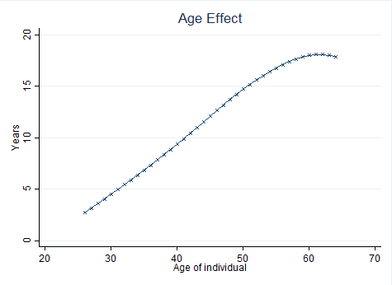
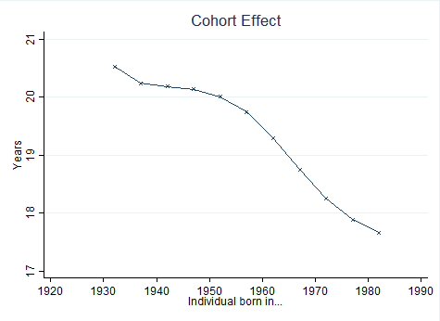
Labor Markets transformations (2) – job tenure
FRANCE
On average, youngest cohorts have a 2 to 3 year shorter tenure than the oldest cohorts in most of the EU
12

Slide 13
Labor Market transformations (2)
Growth of Non Standard forms of Employment (NSE) has been significant
FRANCE
ITALY
POLAND
Source: Labor Force Surveys (Eurostat)
On average, Non Standards forms of Employment have grown around 5-7 percentage points in the last 20 years, moving from around 10%-12% of total employment in 1995 to 17%-19% of total employment in 2015.

Slide 14
Long term evolution of inequality of opportunity
Has the proportion of inequality of incomes (or education) explained by circumstances increased over time?
Some stylized facts for Italy, Germany, France, UK for varying period between 1970s – 2010s.
inequality of opportunity represents an important portion of total income inequality, with values ranging from 30% to 50% according to standard deviation of logs (and reaching a lower share in case of mean log deviation).
in general, inequality of opportunity shows a stable or declining pattern;
there has been a clear enhancement of equality of educational opportunities (as captured by the intergenerational education persistence);
in some countries the egalitarian process taking place in the education system has failed to translate into decreasing opportunity inequality in the space of income because of the increasing role of parental networking and the reduced “value” of education in the labour market. This mechanism seems to be at work notably Italy;
in some other countries (France, Germany and Great Britain), where both returns to education and the family networking followed a more constant pattern, inequality of opportunity seems to decrease both in the education and in the income space.

Slide 15
Social Mobility - Inequality of Opportunity for Education (East)
Changes in inequality of opportunity for tertiary education in transition economies
Source: Brock et al. 2016

Slide 16
A new social contract? Policy discussion

Slide 17
Distributional tensions and policies
Public redistribution and social protection against risks; main instruments:
Redistribution via tax and transfers; or
Predistribution:
Pre-market: skills, health, inheritance;
In-market: regulation of labor market, corporate governance, financial policy
In the lights of the (emerging) distributional tensions, are these still working?
Three remedies:
Curb the trends, turn the clock back
Compensate the losers (targeted versus universal approaches)
Direct the processes to minimize losses

Slide 18
Re-distribution in ECA
Welfare systems in Europe have a fundamental role in reducing inequalities of market incomes
Source: own calculations based on EUROMOD G4.0 (2016 tax/benefits systems, 2012 EU SILC input data)

Slide 19
Changes in redistribution

Slide 20
Labor Market regulations
Decline in job tenure for younger cohorts is not driven by a composition effect due to the increase in non-standard forms of employment (NSEs)
Employment Protection, which has been going down in most countries, has a strong positive impact on tenure in the short run but with a surprisingly low persistence.

Slide 21
Distributional tensions and a crisis of the social contract

Slide 22
A crisis of the social contract
How to measure the cracks in the social contract?
Labor strikes, demonstrations… to full blown social unrest, and civil wars
Voting patterns
Opinion surveys: trust of the government, institutions;
Perceptions of inequality

Slide 23
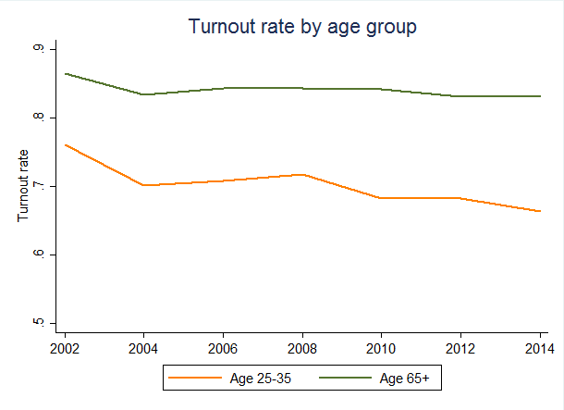
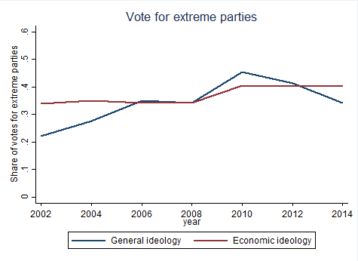
Voters decrease their support for centrist parties Populism rise: in Europe
Source: Winkler (2017) “The Effect of Income Inequality on Political Polarization: Evidence from European Regions, 2002–2014”.
Note: Data are from a merge of the European Social Survey (bi-annual from 2002 to 2014; includes 25 European countries; relevant question is “Which party did you vote for in the last election”?) and Chapel Hill Expert Survey (CHES), which contains information on the ideological content of each party for every four years from 1999 to 2014 . The CHES asks experts to place multiple political parties on an ideological scale from extreme left (0) to extreme right (10).
Notes:
Emphasize 2 things:
That young turnout rates are much lower;
That actually the young turnout rates are going down!
Turnout rates in 2002: Age 25-35 (76%) Age 65+ (86%)
Turnout rates in 2014: Age 25-35 (66%) Age 65+ (83%)
Vote to parties on the extreme 10% of the ideological spectrum:
Low education (0-5 yrs of schooling): 9.4% in 2002, 14.3% in 2014 (+5 percentage points)
Mid education (6-12 yrs of schooling): 7.5% in 2002, 18.4% in 2014 (+11 percentage points)
High education (13+ yrs of schooling): 7.1% in 2002, 12.8% in 2014 (+5.7 percentage points)
Non-routine, manual: 7.9% in 2002, 16.5% in 2014 (+8.6 percentage points) Routine: 8.2% in 2002, 17.9% in 2014 (+9.7 percentage points) Non-routine, cognitive: 6.6% in 2002, 11.7% in 2014 (+5.1 percentage points)

Slide 24
Voters decrease their support for centrist parties Populism rise: in Europe
Source: Winkler (2017) “The Effect of Income Inequality on Political Polarization: Evidence from European Regions, 2002–2014”.
Note: Data are from a merge of the European Social Survey (bi-annual from 2002 to 2014; includes 25 European countries; relevant question is “Which party did you vote for in the last election”?) and Chapel Hill Expert Survey (CHES), which contains information on the ideological content of each party for every four years from 1999 to 2014 . The CHES asks experts to place multiple political parties on an ideological scale from extreme left (0) to extreme right (10).
Notes:
Emphasize 2 things:
That young turnout rates are much lower;
That actually the young turnout rates are going down!
Turnout rates in 2002: Age 25-35 (76%) Age 65+ (86%)
Turnout rates in 2014: Age 25-35 (66%) Age 65+ (83%)
Vote to parties on the extreme 10% of the ideological spectrum:
Low education (0-5 yrs of schooling): 9.4% in 2002, 14.3% in 2014 (+5 percentage points)
Mid education (6-12 yrs of schooling): 7.5% in 2002, 18.4% in 2014 (+11 percentage points)
High education (13+ yrs of schooling): 7.1% in 2002, 12.8% in 2014 (+5.7 percentage points)
Non-routine, manual: 7.9% in 2002, 16.5% in 2014 (+8.6 percentage points) Routine: 8.2% in 2002, 17.9% in 2014 (+9.7 percentage points) Non-routine, cognitive: 6.6% in 2002, 11.7% in 2014 (+5.1 percentage points)

Slide 25
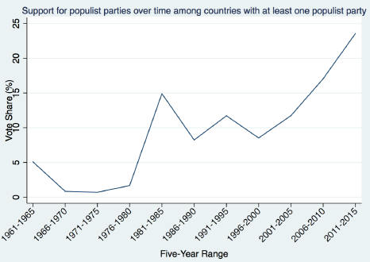
Populism rise: Globally
Source: Rodrik, D. (2017). Populism and the Economics of Globalization.
Note: The populism database used to construct the figure is based on the Global Elections Database (GED) and the Constituency-Level Elections Archive (CLEA). Rodrik defines populist parties loosely as those which pursue an electoral strategy of emphasizing cleavages between an in-group and an out-group. Parties are coded as populist in the dataset if they are labeled as such in the academic or journalistic literature at some point in their history and fit this definition.
Notes:
IMPORTANT POINT: populism is not new. It has been brewing since the early 1990s.
And one can see that there are economic roots (the losers of the globalization process, especially in high income countries), a new interesting question is what type of populism arise from these economic roots. Both left and right kinds of populism have arisen. See Rodrik 2017 on this.
The rejection of established elites is perhaps the defining characteristic of a populist movement, yet what is not always clear is why mainstream parties should be so unresponsive in the face of discord. In another new paper, Luigi Guiso, Helios Herrera, Massimo Morelli and Tommaso Sonno provide a clever framework for answering that critical question. Establishment parties, they suggest, cannot respond to supporters’ concerns because of their respect for institutional constraints, like the rules of the European Union, or because of an unwillingness to break norms like repaying sovereign debt.
But keeping faith with institutions can mean letting down voters. When elected leaders fail to deliver hoped-for improvements, the public disengages. Depressed turnout is an opportunity for political entrepreneurs. Almost invariably, the authors argue, populists promise to relieve the stresses caused by institutional constraints. But the genre of populism depends on how turnout varies in some groups compared with others. If right-wing voters (such as older men) are less prone to sit out elections, then a populist candidate is more likely to be right-wing. Populist policies vary as a result: a left-wing firebrand might attack the budget strictures imposed by European institutions, whereas a right-winger might focus on ending free movement of labour.
http://www.heliosherrera.com/populism.pdf

Slide 26
A growing trust deficit
Notes:
Source: ECA Economic Update 2016. Life in Transition Survey (LiTS) II and III.
Note: The question in the survey is: “To what extent do you trust the following institutions?”. Each respondent can choose between (answer=1)
complete distrust, (answer=2) some distrust, (answer=3) neither trust nor distrust, (answer=4) some trust, and (answer=5) complete trust. The lefthand
side panel shows the share of respondents (as a simple average across all countries in LiTS surveys) that choose complete distrust to this
question in 2015 (LiTS III). The right-hand panel shows the changes in the share of respondents that indicated complete distrust for each institution
between 2010 and 2015.

Slide 27
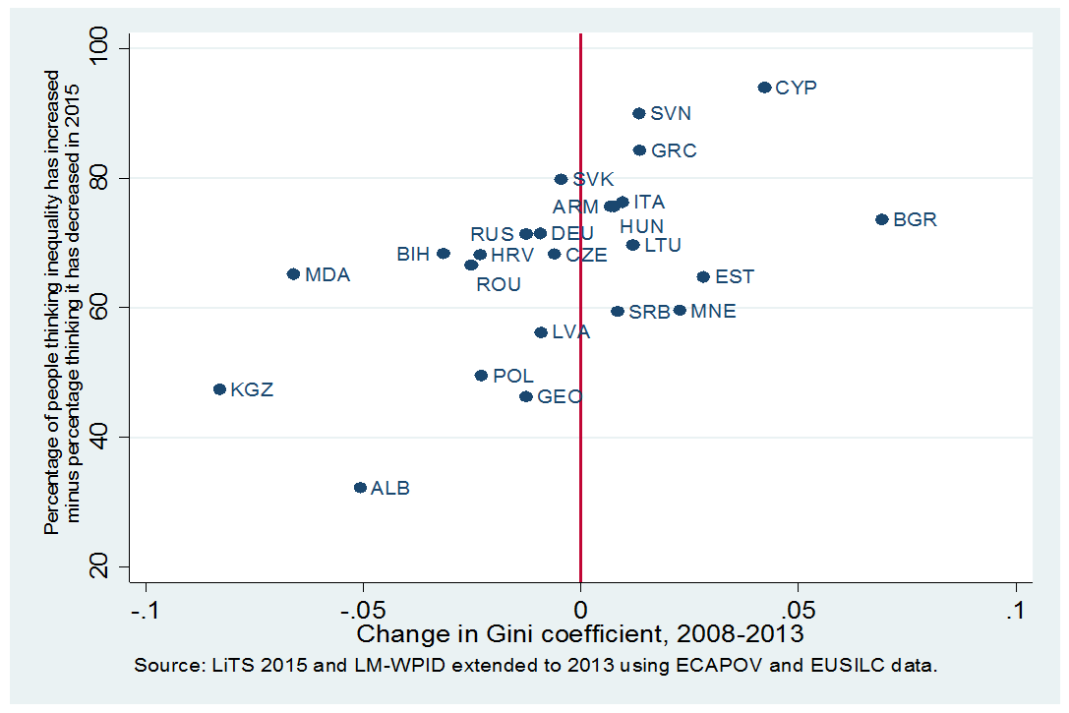
Inequality: perception vs objective trends
Source: EBRD transition report, and Bussolo, Ferrer-i-Carbonell and Giolbas (forthcoming background paper)

Slide 28
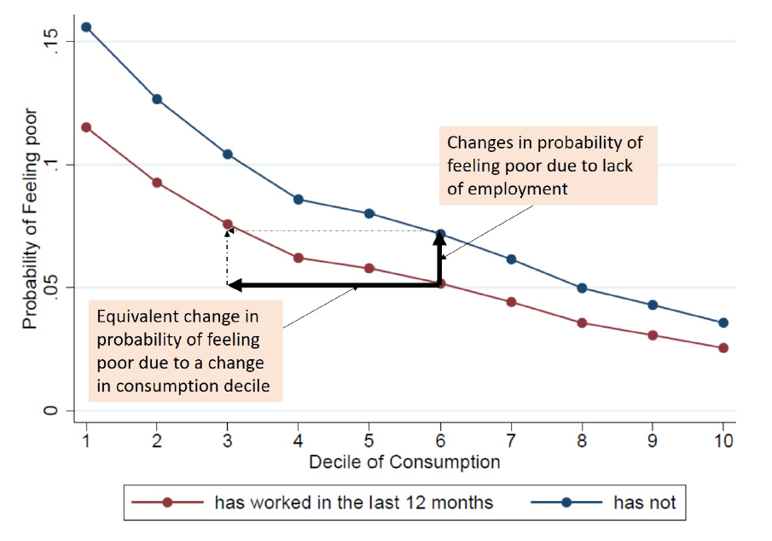
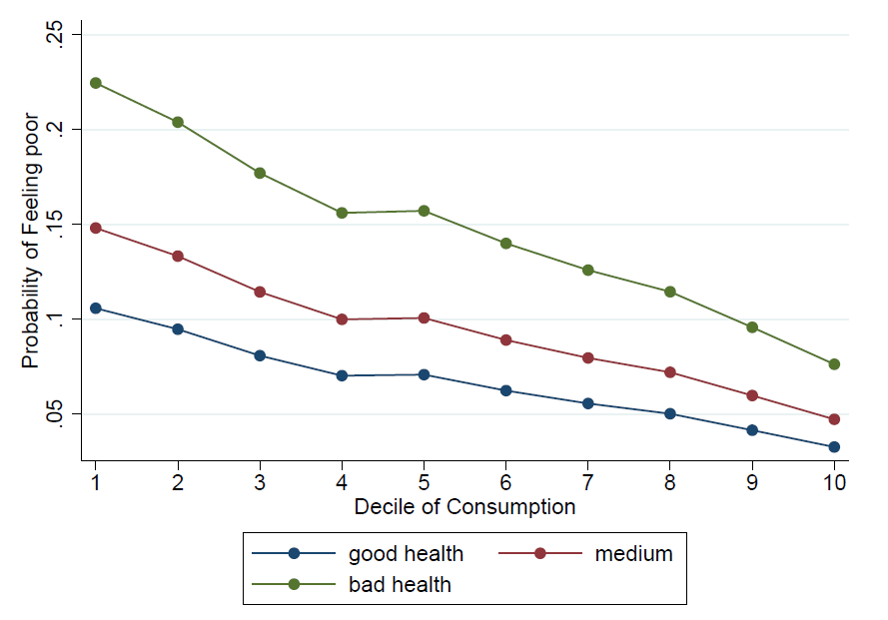
Inequality or fairness? Or insecurity?
Probability of placing oneself in the bottom two ladders of the Cantril's Ladder. Estimated from Life in Transition Survey datasets using:
Source: Bussolo, Lebrand (forthcoming background paper)

Slide 29
Challenges of a new ‘universal’ model…
Avoid divisive and stigmatizing forms of support
Address the criticism, from both left and right, that the welfare state is not really emancipating beneficiaries: Reduce dependence on the family, the labor market, the state
Enhance quality of social interactions in important institutions (family, firm)
Compatible with globalization, automation, migrations, environmental crisis
Suitable for emerging economies
Adapted from Marc Fluerbaey presentation
29

Slide 30
Strong focus on universal individual rights instead of redistribution
Rights to basic services: education (incl. continued), health, child and elderly care
Rights to participation and status: firms (codetermination/unions?), public agencies and politics, civil society organizations, family
Rights to economic security: share in inheritance pool, basic income/employment
Adapted from Marc Fluerbaey presentation

Slide 31
Rely on efficiency-enhancing taxes
Environmental taxation
Real estate taxation
Risky financial activities
Advertising arms race
HR experience rating
Social/environmental penalties on imports
Tax or cap on received inheritance
Tax on mergers and high market shares
Adapted from Marc Fluerbaey presentation

Slide 32
Thanks

