Slide 1
Patients as Consumers in the New Market for Medicine
Evidence From American hospitals
Cristobal Young
Stanford University
Xinxiang Chen
National Strategic Planning & Analysis Research Center, Mississippi State University

Slide 2
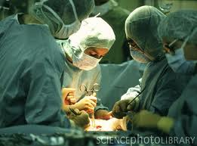
Two Dimensions of Hospital Care
Technical Medical Quality

Slide 3

Two Dimensions of Hospital Care
Technical Medical Quality
Hospitality
(Room and Board)

Slide 4
The Partial Information Problem
Podolny & colleagues : Decoupling of social status and individual merit

Slide 5
The Partial Information Problem
Podolny & colleagues : Decoupling of social status and individual merit
“Halo Effect” of physical attractiveness

Slide 6

The Partial Information Problem
Podolny & colleagues : Decoupling of social status and individual merit
“Halo Effect” of physical attractiveness
Used car market: cleanliness as evidence of mechanical condition

Slide 7

Data Set
Research run by Medicare (CMS)

Slide 8
Data Set
Research run by Medicare (CMS)
2,200 hospitals in the US, during 2007 - 2010
Hospital-level data on patient satisfaction
and medical quality

Slide 9


Data Set
Bay Area: about 30 hospitals, including:
UCSF Medical Center
Stanford Hospital
San Francisco General
9 Kaiser Foundation hospitals, including
Kaiser Fremont / Hayward

Slide 10
Patient Satisfaction
Outcome
Variables

Slide 11
Patient Satisfaction
Outcome
Variables
Patient Recommendation

Slide 12

Preview: Mortality Rates and Patient Satisfaction

Slide 13
Preview: Mortality Rates and Patient Satisfaction
Medicare flags the hospitals with the BEST and the WORST survival rates
Heart Attack and
Heart Failure care

Slide 14
Patient Satisfaction at Best and Worst Hospitals

Slide 15
Patient Satisfaction at Best and Worst Hospitals

Slide 16
Patient Satisfaction at Best and Worst Hospitals

Slide 17
Medical Quality – Process of Care
Heart Attack Care (examples):
Aspirin at Arrival (and discharge)
Beta Blocker at Arrival (and discharge)
ACEI or ARB for LVSD

Slide 18
Medical Quality – Process of Care
Heart Attack Care (examples):
Aspirin at Arrival (and discharge)
Beta Blocker at Arrival (and discharge)
ACEI or ARB for LVSD
Fibrinolytic Therapy Received Within 30 Minutes of Hospital Arrival
Primary PCI Received Within 90 Minutes of Hospital Arrival

Slide 19
Medical Quality – Process of Care
Heart Attack Care (examples):
Aspirin at Arrival (and discharge)
Beta Blocker at Arrival (and discharge)
ACEI or ARB for LVSD
Fibrinolytic Therapy Received Within 30 Minutes of Hospital Arrival
Primary PCI Received Within 90 Minutes of Hospital Arrival
Pneumonia
Oxygenation Assessment
Pneumococcal Vaccination
Blood Cultures Performed in the Emergency Department Prior to
Initial Antibiotic Received in Hospital

Slide 20
Hospitality / “Room and Board” Care
Pain well controlled?

Slide 21
Hospitality / “Room and Board” Care
Pain well controlled?
Quiet / clean room?

Slide 22
Hospitality / “Room and Board” Care
Pain well controlled?
Quiet / clean room?
Nurse Communication:
1. "did nurses treat you with courtesy and respect?"
2. “explain things in a way you could understand?”
3. “listen carefully to you?”

Slide 23

Part 1. Positive Response Models
Percent reporting “high” satisfaction with hospital
Percent “definitely” recommending

Slide 24
Part 1. Positive Response Models

Slide 25
Part 1. Positive Response Models
Elasticities

Slide 26
Part 1. Positive Response Models
Elasticities

Slide 27
Part 1. Positive Response Models
Elasticities

Slide 28
Effects of Medical Quality and Nurse Communication on Satisfaction

Slide 29

Part 2. Negative Response Models
Percent reporting “low” satisfaction with hospital
Percent “definitely NOT” recommending

Slide 30
Part 2. Negative Response Models
Elasticities

Slide 31
Part 2. Negative Response Models
Elasticities

Slide 32
Part 2. Negative Response Models
Elasticities

Slide 33




What Do Nurses Do?

Slide 34

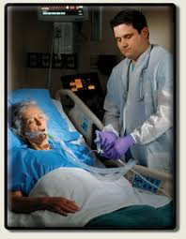
What Do Nurses Do?

Slide 35

Part 3. Hospital Competition
and Patient Satisfaction

Slide 36
Part 3. Hospital Competition
and Patient Satisfaction
Smaller sample
N ≈ 450

Slide 37
Part 3. Hospital Competition
and Patient Satisfaction
Smaller sample
N ≈ 450
2. 18 measures of local competition

Slide 38
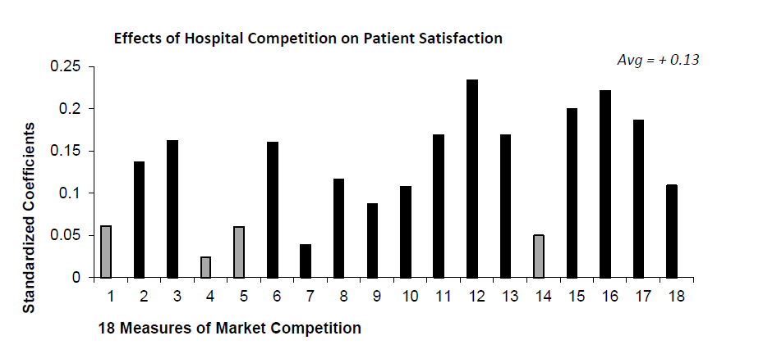

Slide 39
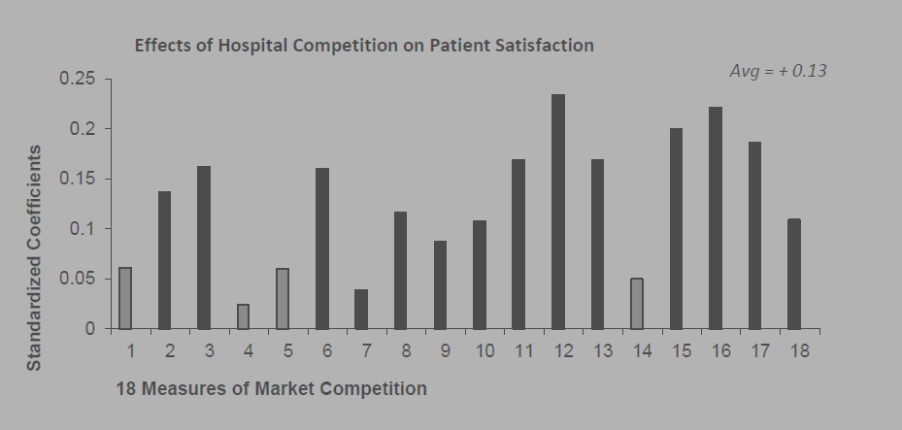
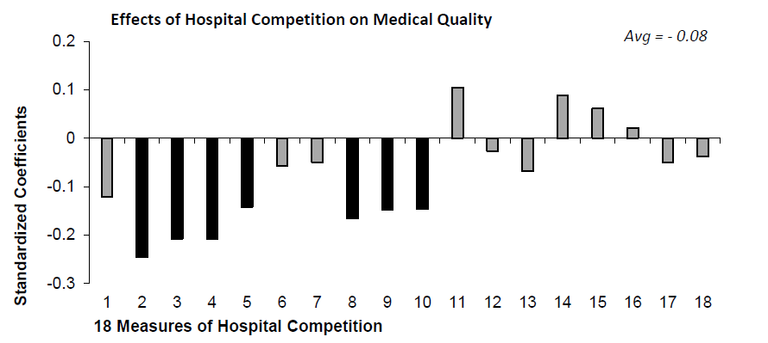

Slide 40
Recap
1. Medical quality has little effect on patient satisfaction and loyalty

Slide 41
Recap
1. Medical quality has little effect on patient satisfaction and loyalty
2. Hospitality has large effect

Slide 42
Recap
1. Medical quality has little effect on patient satisfaction and loyalty
2. Hospitality has large effect
3. Death rate has no effect on patient satisfaction

Slide 43
Recap
1. Medical quality has little effect on patient satisfaction and loyalty
2. Hospitality has large effect
3. Death rate has no effect on patient satisfaction
4. Competition: Hospitals into hotels

Slide 44
Implications
How should we think about markets for professional services?

Slide 45

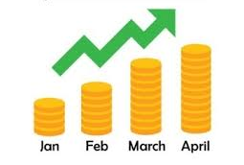
Consumption
Versus
Investment
Tastes good!
Long-term benefits

Slide 46
Vs.
current enjoyment / long-term benefits /
consumption investment

Slide 47
Vs.
current enjoyment / long-term benefits /
consumption investment
Health Care: hospitality vs. medical quality
Hospitals into hotels

Slide 48
Vs.
current enjoyment / long-term benefits /
consumption investment
Health Care: hospitality vs. medical quality
Hospitals into hotels
Education: Paying for the Party (Armstrong & Hamilton)
Training future leaders vs.
Four years of summer camp for the price of a Bentley

Slide 49
Vs.
current enjoyment / long-term benefits /
consumption investment
Health Care: hospitality vs. medical quality
Hospitals into hotels
Education: Paying for the Party (Armstrong & Hamilton)
Training future leaders vs.
Four years of summer camp for the price of a Bentley
Journalism: The “forth estate” or a “market for clicks”?
How to balance what citizens “need to know” with
what is exciting, provocative, attention-getting?
Should I read things that make me an informed citizen, or should I read about what the President wrote on twitter this morning?

Slide 50

Vs.
current enjoyment / long-term benefits /
consumption investment
Health Care: hospitality vs. medical quality
Hospitals into hotels
Education: Paying for the Party (Armstrong & Hamilton)
Training future leaders vs.
Four years of summer camp for the price of a Bentley
Journalism: The “forth estate” or a “market for clicks”?
choosing between
consumption
&
investment
is hard
How to balance what citizens “need to know” with
what is exciting, provocative, attention-getting?
Should I read things that make me an informed citizen, or should I read about what the President wrote on twitter this morning?

Slide 51

Thank You!
Contact:
cristobal.young@stanford.edu

