Slide 1
Understanding Charitable Giving and Charity Revenues
A. Abigail Payne
Director & Ronald Henderson Professor

Slide 2
Why study charitable giving?

Slide 3
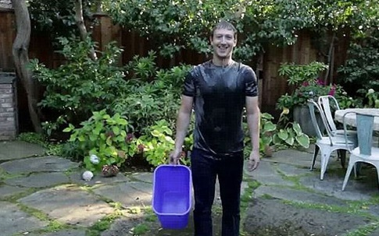


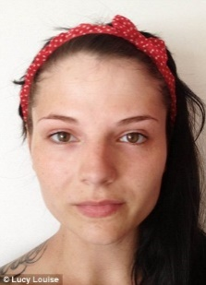
1. Social Media is Changing the Face of Giving
Ice Bucket Challenge
  Started in 2013 as “cold water challenge” …2014: Golf Channel: Live “Ice Bucket Challenge” ... This led to high profile personalities Justin Bieber to George W. Bush
  Since July 2014: $115 M in donations
Movember
  Australia: 2000 Not recognized until 2006 in North America
  2010: raised $5 million; 2012: raised $95 million .. $100 M USD in 2014
San Francisco Make a Wish Foundation: asked for a few volunteers to create Batkid day for a child cancer survivor Miles Scott …. 12,000 individuals volunteered
2014: No makeup selfie to increase Cancer awareness … Kim Kardashian, Gwyneth Paltrow, J Lo …. $8 Million in 6 days

Slide 4

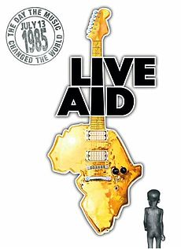
1. Social Media is Changing the Face of Giving
Jerry Lewis Labor Day Telethons for Muscular Dystrophy (1952-2010)
  Raised USD $1 M in 1960s
    ~$10 M USD in 1970s
Old folks .. social media is a new twist
1985: big blitz: Live Aid Concert in UK & US for Ethiopian Famine Relief
  Estimates of what was raised: between $80 - $230 Million (CAD)
  … today $150 M - $457 M

Slide 5
1. Social Media is Changing the Face of Giving
What has changed from Jerry Lewis to today?
  Fixed goals of funding v. the sky is the limit?
  Sheer magnitude?
  Diffusion of networks?
Differences in how we appeal to individuals?
  Brain …
  Feeling / Empathy …
  Frenzy … belonging? Role of peers / networking
Who is collecting the money? Charity, individual?

Slide 6
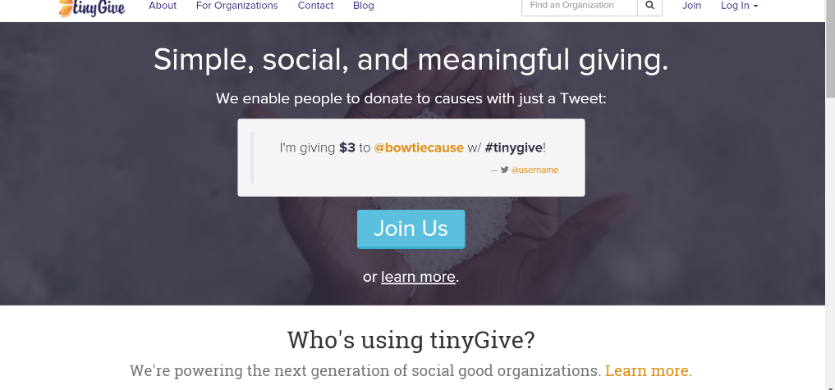
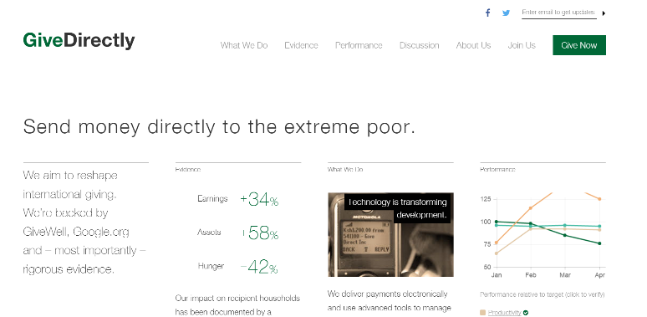
2. Technology is Changing How We Give
Online giving portals
Fundraising pages
Permitting small amounts
Financing of charity –
  from donor ➔ charity/government ➔ recipient
  to donor ➔ recipient?

Slide 7
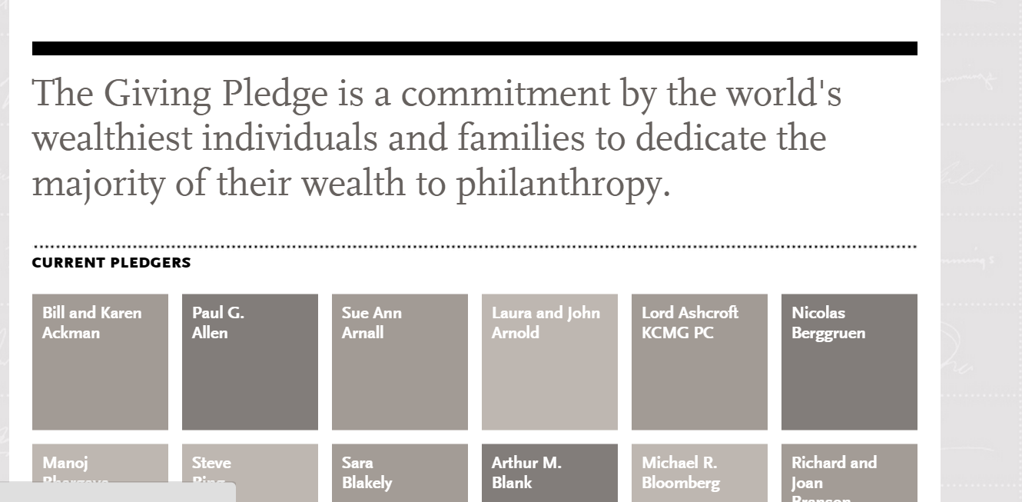
3. Motivating big donors

Slide 8
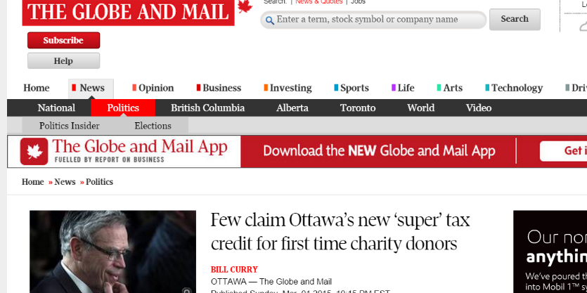
4. Government decisions ..
Tax breaks or not?
Encouraging new or more giving? Impacts of time variation
  Publicly Traded Securities
  First Time Super Credit
  Should we target certain populations?
Treatment of hard to value gifts
  Art, land, hockey sticks
    If organizations are cash strapped can the tax system help?

Slide 9
So many puzzles
How do we model giving?
  Apply models tied to public goods? Private provision?
    What motivates individuals to give?
    Why don’t we see perfect crowd-out of government grants?
    Why does a match increase giving but proportion of the match does not always matter?
Why do we bend to social pressure?
  How does social media enhance giving?
Why is giving as a % of GDP flat in most countries?
  Do tax incentives matter?
Does impact matter?

Slide 10
Data & Statistical issues for studying charitable giving…
How do we measure giving?
  Individual donations
    Tax filer data?
    Charity level data?
How do we capture public support?
  Government grants/funding
    Overall programs
    Charity level data?
Fundraising : How measured? Charity or individual driven?
Role of Volunteers
Capturing impact?
Endogeniety, omitted variables

Slide 11
Theme #1: Does Crowd out exist?
Measuring how government funding affects private giving

Slide 12
Starting Point … how do we think about giving?
If a ~public good – private provision is insufficient

Slide 13

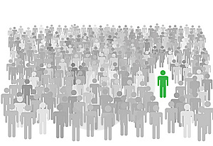

Thinking about Role of Government on Giving
Enter Government …
Donors are Taxpayers
Utility:
Overall Donation (D)?
Individual Gift (d)?
Many donors are asked to give
ROLE OF FUNDRAISING
Charity: Are the goods and services
Akin to public goods?

Slide 14
Should Government Provision be Direct or Indirect?
Historic Argument
  If direct provision ➔ crowd out
  Promote indirect provision ➔ tax incentives, matching, etc.
Why this argument might not hold
  Crowd out is not perfect – warm glow … and/or role of fundraising
  Donors use other funding as a signal - e.g. research funding, foundation grants
  Cost of monitoring tax v. direct grants
  Differentiation across types of charities – private v. public
  Are donors sensitive to tax price of giving?

Slide 16
Is crowd-out driven by fundraising?
Andreoni & Payne (2003); Andreoni and Payne (2011); Andreoni and Payne (2017)
  Twist to Model: Charities are not passive in the collection of donations
    Fundraising: Power of the Ask & Provides Information to Donor
      Can lead to increasing # of donors (extensive) as well as donation amount (intensive)
    Charity behaviour: NOT profit maximizing
  Propositions from theory
    Increasing government grants to a charity ➔ decreases fundraising efforts
  Empirical Analysis – Crowd-out exists but mostly driven by a change by the charity in fundraising expenditures

Slide 17
Theme #2 .. Can Funding Lead to Persistent Positive Effect In Revenue Growth for charities?

Slide 18
Do targeted grants affect revenues differently?
Andreoni, Payne, Smith (2014), Minaker and Payne (2017)
  Targeted funding
    Specific projects … e.g. seed funding ➔ crowd-in?
Differential Effects based on size of charity
    Bigger positive effects for small and medium sized charities
Persistent Effects

Slide 19
What are key aspects to the analysis?
Charities are ACTIVELY seeking funding
  Rejected applicants might pursue other funding strategies
HIGHLY RESPECTED source of funding
  Could have bigger impact on smaller charities
Expectation of NEW or EXPANDED service provision
FUNDED ONCE … consider what is source of future support?
  Charities w/ multiple grants expected to be targeting different services
TYPICALLY NO MATCHING REQUIRED

Slide 20
Examples of grants – New or continuing initiatives?
2000: Clean North (protection of the environment): $20,000 to bolster blue box use
2000: Church in the Great Hall: employment for street youth $119,000
2004: Garden River First Nation: $75,000 sports program for at-risk youth
2004: Toronto Christian Resource Centre: $67,400 to reduce isolation of Bangladeshi-Canadian Women
2009: Planned Parenthood Waterloo: $44,100 to support women from the Sudan and Afghanistan on issues related to rape and sexual assault

Slide 21
Government Grants – what we expect to see; Total Revenue: increasing

Slide 22
Summary Stats

Slide 23
Identification strategy
Basic .. Pre/Post with charity fixed effects
Unlike APS – don’t have scores .. But have observables used for evaluation .. Matching on observables
  Trim the rejected applicants to find those that appear to be close to cut off for funding
  Effects smaller when use this strategy
Before App
Post Application
App/Funding

Slide 24
Table 4: Effect of Successful Award

Slide 25
Table 5 Effect of Grant Value
Overall Revenues .. Testing for Crowd-Out ..
0 = complete; (0,1) = partial; 1 = neutral; >1 = crowd-in
note: matching charities .. ~ if not matched

Slide 26
Theme #3 .. Are donors sensitive to the tax price?

Slide 27
Advantage of reducing tax price (v. govt provision)
Allows donors to direct their giving (v. political economy process)
Most tax systems encourage giving …
  US a deduction for itemizers -- ~$51 B, 0.29% of GDP
  Canada non-refundable tax credit -- $2.5 B, 0.14% of GDP
    Efficient incentive when elasticity = -1
Long literature w/ range of estimates {-1.7 to -0.08}
  Challenging to estimate
Use of Canadian data: cleaner estimates
  Study broad group of taxpayers
  Permits estimation of an extensive margin

Slide 28
Results

Slide 31
Measuring Donor Responsiveness to Tax Price in Canada
Tax price elasticity in line with the rest of the literature
  Strongest effects for lower part of the distribution
  Credits for donations >$200 has the biggest impact
Evidence of an extensive margin effect

Slide 32
Wrapping Up

Slide 33
What are some of the issues on charitable giving and support for charitable operations
Individual behaviour …
  …is sensitive to the price of giving
    Extensive & intensive margins
    There may be differences in behaviour across the income distribution
    Sensitivity may be tied to size of donation
  … will react to changes in government funding
    Likely not dollar for dollar
      Charities play a role
      Warm glow plays a role
Charity behaviour …
  Is likely not profit maximizing
    Contributes to notions of crowd out through their fundraising behaviour
Government funding
  Will displace private funding – linked to donors and charity behaviour
  Can affect direct giving (through indirect funding such as tax breaks)
  Can promote persistent / longer term effects … tied to size of charity and type of funding

Slide 34
Thank You!

