Slide 1
Can People ‘Like Me’ Go to College? Inequality and Academic Motivation
Neil A. Lewis, Jr.
Cornell University
Presentation Prepared For:
Cornell-Stanford Conference on Public Goods, Commodification and Rising Inequality
November 3, 2017
@NeilLewisJr
Notes:
Today I’m going to talk about some recent work my collaborators and I have been doing on how inequality can influence students’ academic motivation and success in education.

Slide 2
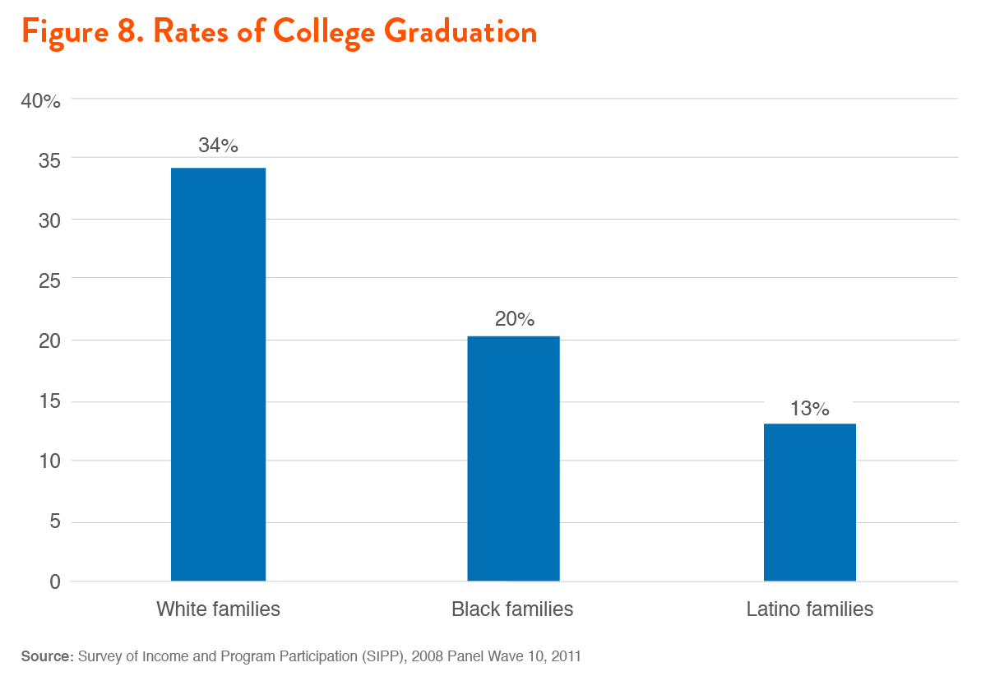
Disparities in Educational Attainment
@NeilLewisJr
Notes:
The place we started with this work was trying to understand population level disparities like this.
In the United States, Whites are more likely to obtain college degrees than racial-ethnic minorities, and…

Slide 3
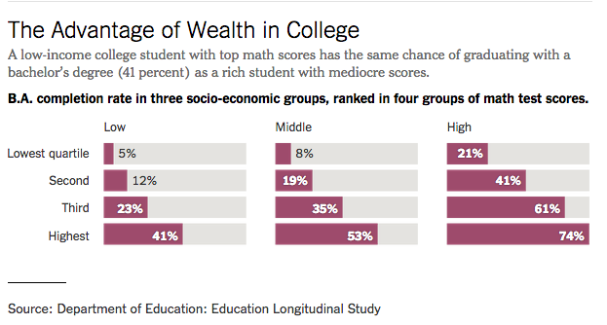
Disparities in Educational Attainment
@NeilLewisJr
Notes:
…people from wealthy families are much more likely to obtain college degrees than people from poor families, an advantage so powerful that at least one analysis from the department of education noted that a mediocre rich student has about the same chance of graduating from college as the highest performing poor student.
This is probably not news to many people in the room. Patterns like this have persisted for decades and forecasts suggest that without intervention they will continue for another 75-100 years depending on which metrics you’re using.

Slide 4
Two Questions
Why do these disparities occur?
What can be done to reduce them?
@NeilLewisJr
Notes:
That’s led us to ask two questions: first why do these disparities occur? And second, if we don’t want to wait another century, what can we do to reduce them.

Slide 5
Mechanisms Underlying Disparities
Historical Context
Discriminatory policies (e.g., mortgage red-lining) produced differential access to social and economic capital.
While no longer legal, we still see effects of those policies today.
Lewis & Oyserman, 2016, Behavioral Science & Policy | Oyserman & Lewis, 2017, Social Issues & Policy Review
@NeilLewisJr
Notes:
We spent some time reviewing disparities literature across the social sciences. We ended up writing two different policy-oriented review papers on this – one on health disparities and another on education disparities. I’m going to focus on education today, but keep in mind that the processes I’ll talk about also have implications for disparities in health outcomes.
There are a few key findings that will give some context to the problem and what to do about it.
We have to start with the historical context

Slide 6
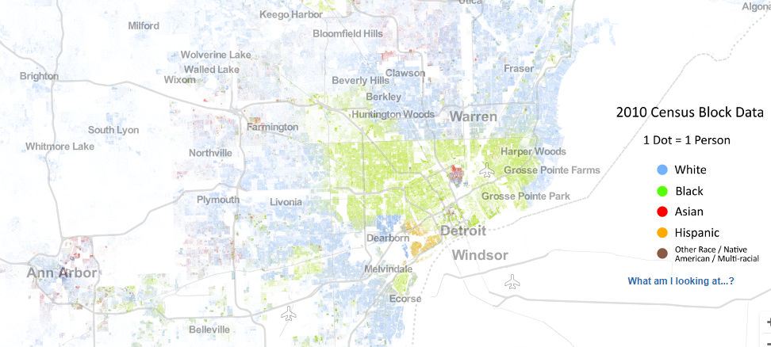
Mechanisms Underlying Disparities
@NeilLewisJr
Notes:
If you take the most recent census and map it, you see patterns like this all across the US.
We still have high levels of racial segregation.
If I had a map of family wealth it would quite similar because in the US race and wealth are inextricably linked.

Slide 7
Mechanisms Underlying Disparities
Black and Latino students attend highly segregated schools in which 90% or more of students are racial-ethnic minorities and low-income.
Live in contexts that have:
Highly segregated, academically low performing schools
Low density of college graduates
Boschma & Brownstein, 2016 | Hannah-Jones, 2014 | Oyserman & Lewis, 2017, Social Issues & Policy Review
@NeilLewisJr
Notes:
Why does that matter?
That put us in the following situation

Slide 8
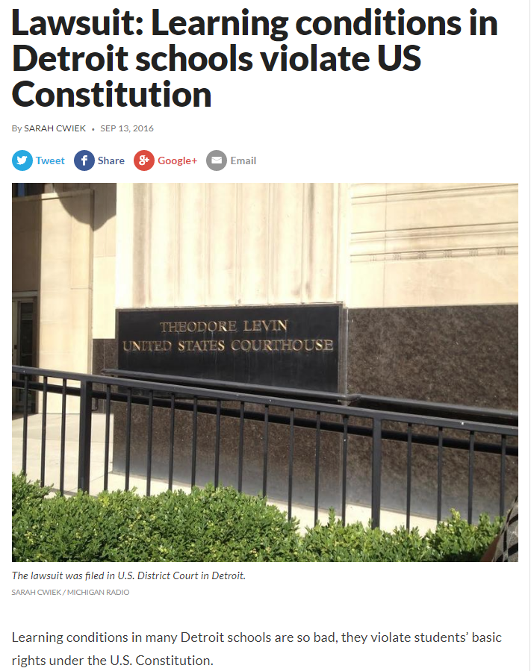
Mechanisms Underlying Disparities
@NeilLewisJr
Notes:
Because schools are funded largely by property values, these schools have less resources and are thus often worse than the schools of their White and wealthy peers.
For example, DPS is currently being sued for violating the equal protection clause

Slide 9
From Stratification to Motivation
Living in places with more college graduates means attending better schools.
It also means having access to models of people ‘like me’ who have succeeded.
These people can show students not only the destination (college), but also the path to get there.
Oyserman & Lewis, 2017, Social Issues & Policy Review
@NeilLewisJr
Notes:
These social contexts matter for motivational processes.
Accesses to people who have succeeded and can show you the way.
This matters a lot for whether the journey seems possible for you

Slide 10
From Stratification to Motivation
Stratification
Poverty
Family Education
Race-ethnicity
Identity-based Motivation
Which identities come to mind
What they imply for which strategies to use
What they imply for how to interpret experiences
Academic Outcomes
Lewis & Oyserman, 2016, Behavioral Science & Policy | Oyserman & Lewis, 2017, Social Issues & Policy Review
@NeilLewisJr
Notes:
Patterns of stratification can influence:
How often you’re thinking of yourself as a college-bound person
Whether you learn the strategies that are necessary to get there, and how you can use them.
How you think about the experiences along the way, particularly the experience of difficulty. When the going gets tough as it inevitably will, does that mean it’s not worth your time and you should give up or does it mean this is important – no pain, no gain.

Slide 11
From Stratification to Motivation
Aelenei, Lewis, & Oyserman, 2017, Study 1, Contemporary Educational Psychology
@NeilLewisJr
Notes:
We have evidence that patterns of stratification influences each of these components that are important for keeping students persisting.
To provide one example, we recently surveyed a little over a thousand Americans about how they interpret difficulty – specifically to what extent do they agree that difficulty is a signal of importance when working on tasks. We focused on that mindset because there is plenty of evidence that the more people believe that, the more they persist in the face of adversity, and that mindset is very predictive of students’ success. What did we find?
Results.
This makes sense: If you’re working 2 or 3 jobs and not making progress, it’s hard to agree that difficulty means importance. But imagine the child being raised in that environment where they’re constantly exposed to people who are working hard but making no headway – that can change the way they think about whether their own efforts are likely to matter for things like school. In fact the second study of this paper we show that those students even when in college are less certain that they can succeed; this can help us start to understand differential attrition.

Slide 12
From Stratification to Motivation
Stratification
Poverty
Family Education
Race-ethnicity
Identity-based Motivation
Which identities come to mind
What they imply for which strategies to use
What they imply for how to interpret experiences
Academic Outcomes
Lewis & Oyserman, 2016, Behavioral Science & Policy | Oyserman & Lewis, 2017, Social Issues & Policy Review
@NeilLewisJr
Notes:
I don’t want to leave you with just bad news, there are things we can do about this.

Slide 13
From Stratification to Motivation
Stratification
Poverty
Family Education
Race-ethnicity
Identity-based Motivation
Which identities come to mind
What they imply for which strategies to use
What they imply for how to interpret experiences
Academic Outcomes
Lewis & Oyserman, 2016 | Lewis & Sekaquaptewa, 2016 | Oyserman & Lewis, 2017 | Oyserman, Lewis, et al., 2017
@NeilLewisJr
Notes:
The model I showed before is not just a model of understanding, it is also a model of intervention. There are things we can do to help break the cycle and help students…

Slide 14
Seeing the Destination AND the Path
Create connections between students’ aspirations and current identities.
Make behavioral strategies feel congruent with current identities.
Normalize academic difficulties as signals as importance rather than impossibility.
Oyserman & Lewis, 2017, Social Issues & Policy Review
@NeilLewisJr
Notes:
These are the key takeaways on how to do this. We outline concrete steps in the paper.

Slide 15
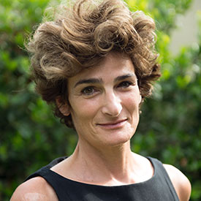
Acknowledgments
Daphna Oyserman
University of Southern California
Cristina Aelenei
Paris Descartes University
@NeilLewisJr

Slide 16
Thank You
nlewisjr@cornell.edu
www.neillewisjr.com
@NeilLewisJr

Slide 17
Mechanisms Underlying Disparities
Aspirations are not the problem
Aspirations are equally high (80-100%) across groups
Lewis & Oyserman, 2016, Behavioral Science & Policy | Oyserman & Lewis, 2017, Social Issues & Policy Review
@NeilLewisJr
Notes:
We spent some time reviewing disparities literature across the social sciences. We ended up writing two different policy-oriented review papers on this – one on health disparities and another on education disparities. I’m going to focus on education today, but keep in mind that the processes I’ll talk about also have implications for disparities in health outcomes.
There are a few key findings that will give some context to the problem and what to do about it.
The first lesson is actually what’s not a problem:

