Slide 1
The Comfort of Clarity
University Rankings and the Demand for Suspect Commodities
Wendy Espeland
Northwestern University
Prepared for the Public Goods and Inequality Conference, Stanford University, November 2-3, 2017.

Slide 2
Rankings are part of a global “accountability” movement: trust in numbers replaces trust in people Quantification is a technology of power We need to investigate it empirically and consider its distributive and normative dimensions accountability and transparency through numbers

Slide 3
Where did educational rankings come from?

Slide 4
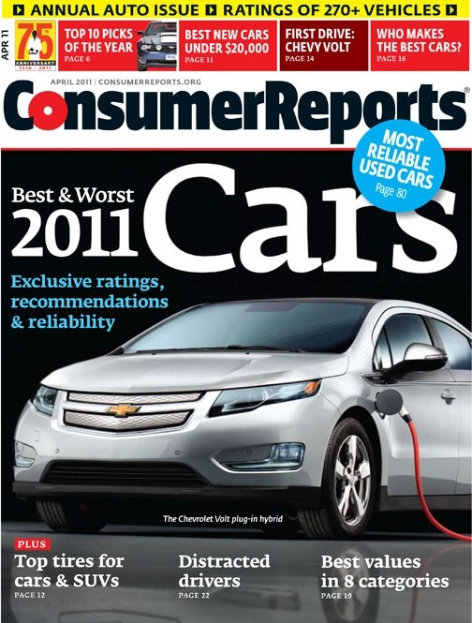
Precursors??
1936
1910

Slide 5
“News You Can Use”
Morton Zuckerman buys USN
Copy the French???
Make a splash! Make $$
Diversification! Mimesis!

Slide 6
DIVERSIFICATION: education

Slide 7
Health care

Slide 8
Misc.

Slide 9
NOT QUITE THE BEST

Slide 10
Copy-cats: More than 40 national rankings
Germany
1998
U.K. 1992
Canada 1991

Slide 11
Global Rankings
“Shanghai Rankings” 2003
THE QS World University
Rankings 2004
Leiden Rankings 2013
THE World University Rankings 2009
QS Word University Rankings 2009

Slide 13
Why are they suspect?

Slide 14
Hint…
1. They are terrible measures made by journalists (and unpaid interns), interested in making and disseminating “news” cheaply, efficiently and profitably.
2. They induce self-fulfilling prophecies and rampant gaming by creating perverse incentives and massive unintended and unacknowledged consequences.

Slide 15
“We know they are deeply flawed measures but…”
“What’s the best way to move up in the “Shanghai” world rankings? Kill the humanities.”

Slide 16
And why do people still use them?

Slide 17
Who uses them? (Sometimes people who hate them).
Prospective students, parents
Other media outlets: easy stories
Faculty
Administrators: chairs, deans , presidents, etc.…
Overseers: trustees, boards of visitors, reagents, state legislators
Employers, etc.

Slide 18
WHY?
They are easy
Others use them and become invested in them
They help us do hard things
They offer a defense/reason to others who want one

Slide 19
What kind of commodities are they?

Slide 20
It depends….and changes over time with use 1. Information—formalized and neatly packaged 2. decision tools— for lots of kinds of decisions 3. performance measures and incentives 4. symbolic systems: markers & makers of status 5. identities 6. expressions of power and privilege

Slide 21
What do they do?

Slide 22
Rankings offer (a form of) clarity….
Higher is better; lower is worse
Difference is a standardized interval: this seems easy to interpret
Simplify complex information that is hard to absorb

Slide 23
Rankings:
Make comparisons easy
They produce trends
They seem like objective/rigorous/scientific measures
They signal

Slide 24
Increase and reinforce inequalities
Access to education
Money for education
Punish heterogeneity– schools w/ different goals, missions
Shift the distribution of resources—rich get richer; focus on the wrong things

Slide 25
Encourage bad behavior & gaming….
Manage the numbers-- not what they are supposed to measure
Promote forms of unwholesome competition (lying, cheating)
Impose a uniform and coercive definition of excellence

Slide 26
The Comfort of Clarity Can Be Costly
Especially if education is supposed to mitigate inequality
Useful is not the same as good

Slide 27
THANKS!
And thanks to Mike Sauder my co-author.

Slide 29
…Since 1981
college rankings: simple survey
annual college rankings issue
1987 college rankings guidebooks

Slide 30
U. S. News graduate school rankings
law school rankings
annual graduate school rankings issue
1994 graduate rankings guidebook

Slide 31
Robert Morse “Mr. Rankings”

