Slide 1
Caste identity, Social Connections and Financial Incentives in the Workplace A Quasi Field Experiment in India’s Manufacturing Sector
Farzana Afridi (ISI Delhi) Amrita Dhillon (King’s College London) Sherry Xin Li (University of Texas Dallas) Swati Sharma (ISI Delhi)
Stanford 2017

Slide 2
Social and economic Inequality in India: the caste system
Legally abolished since 1950 but it continues to define hierarchy and status and is an important marker of economic inequality. Four hierarchical categories divided further into sub-castes. Endogamous. inter-caste marriages rare.
Caste hierarchy is not fixed and changes form. However, there is consensus on which groups constitute the lowest level – Dalits/untouchables usually engaged in degrading work.
Stigmatized social identity, groups are disproportionately poor, have limited access to assets, educational opportunities and decent employment relative to higher caste groups.

Slide 3
Social and economic Inequality in India: the caste system
In 2009, 45.6% of ST and 40.6% of SC as against 30% of OBC and 17.6% of high castes were under the poverty line (Panagriya and More, 2013).
Borooah (2005) estimates that at least 1/3rd of the difference in incomes between households is attributable to discrimination against SC/ST households.

Slide 4
Migration and caste networks in the urban workforce
With modernization, structural transformation – demand for urban labour force increased, leading to increased migration – more than 80% of workforce in NCR garment manufacturing is migrant labour.
Caste based recruitment and residential location – caste is the salient network (Munshi, 2016).
A natural question is to ask: do social networks mediated by caste help to improve productivity/wages/inequality and if so, how?
How do financial incentives affect outcomes?

Slide 5
Factory data from NCR India
We investigate these questions in the private sector – garment factories.
We use factory data to show correlations: the higher the proportion of the same caste in the team, the higher is productivity. This is without financial incentives.

Slide 6
Daily, worker level data on within firm worker productivity
 | Individual worker efficiency | Line level efficiency | Individual worker efficiency | Line level efficiency
 | (1) | (2) | (3) | (4)
Proportion of workers of own caste category in the assembly line | 0.071** | 0.057***
 | (0.031) | (0.019)
Standard deviation of proportion of workers in own caste category in assembly line across work days |  |  | -0.164* | -0.154*
 |  |  | (0.091) | (0.087)
Constant | 0.202*** | 0.200*** | 0.347*** | 0.334***
 | (0.044) | (0.022) | (0.094) | (0.074)
R² | 0.0474 | 0.1850 | 0.0485 | 0.1940
N | 33,704 | 33,704 | 33,702 | 33,702
Notes: Controls include factory floor fixed effects, worker’s individual characteristics. Robust standard errors, clustered at the assembly line level. Significant at *10%, **5% and ***1%. Checked separately for stricter regressions: worker and line fixed effects and daily trends. A 1% increase in proportion implies 7% increase in efficiency.

Slide 7
Interaction between financial and social incentives?
In the factory we see that diversity in the assembly line leads to lower productivity.
To reduce the across caste inequality therefore it might be better to have homogeneous groups…
Tension between benefits of integration in the long term and reducing social inequality.
Can financial incentives substitute for social incentives to cooperate within an assembly line?

Slide 8
Experiment
We conduct a lab experiment using garment factory workers as recruits.
We try to replicate the conditions of the assembly line in the factory but we give team incentives based on minimum output across workers in the team.
Look at homogenous groups: same caste, living in the same neighbourhoods, friends with each other vs heterogenous groups with mixed caste groups, no locational proximity, no friends.

Slide 9
Results
Being in a socially connected (same caste) group increases group output by 15%. Wasted effort is 30% lower for socially connected groups.
This result is driven by low caste workers.
Closer connections to each other – other caste groups are more heterogeneous.
Shared identity of victimhood. This explanation is less likely as caste identity was not primed in our design.
Interaction between financial incentives and social connections: the bonus framing generates significantly more effort when groups are socially connected vs unconnected: complementarity, not substitutability!

Slide 10
Main message for the workshop
In our setting financial incentives (commodification of voluntary public goods provided by caste members to each other which can help to increase productivity) also help to reduce between group inequality in a very narrowly defined sense: low caste groups do better than high caste.

Slide 11
Inequality Trends in Caste
Munshi (2016): trend is of convergence of caste groups in income, education, employment, occupations and access to public goods.
While he attributes some of this to affirmative action, he suggests that caste based networks could have contributed to this trend by exploiting opportunities provided by development.
In our setting, groups are exogenously formed but if employers are aware of the advantages of homogenous groups we may observe more of these groups to exploit the greater trust and public good provision within castes.

Slide 12
Experiment
Location: Delhi- National Capital Region’s garment factory hub
Time line: May - July 2016
Subjects: Garment factory workers recruited through advertisements in their residential areas

Slide 13
Experiment
Subjects’ details on caste, jati and current residence recorded during registration.
Subjects randomly assigned into one of the following groups:
Homogeneous social identity: same caste group and same current residence
Heterogeneous social identity: different caste group and different current residence
Each group consisted of 4 subjects of same gender
Assigned individual task: Fill as many 20 cm. wires with beads of one of four assigned colors in 10 minutes.
Group output: Bracelets, each consisting of four colored strings.

Slide 14
Experiment
Priming of group social identity by announcing names & residence in all sessions:
“अब मैं आप लोगो के नाम और आप की बस्ती का नाम बोलूंगी| जैसे - जैसे मैं आपका नाम लूं आप अपना हाथ उठायें| यदि इस जानकारी में कोई गलती है तो आप हमे उसके बारे में बताएं|”

Slide 15
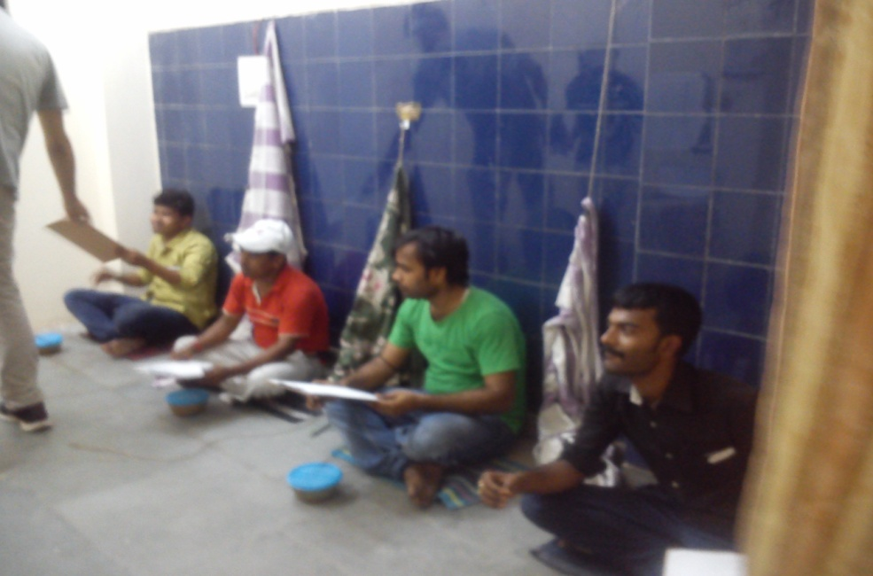
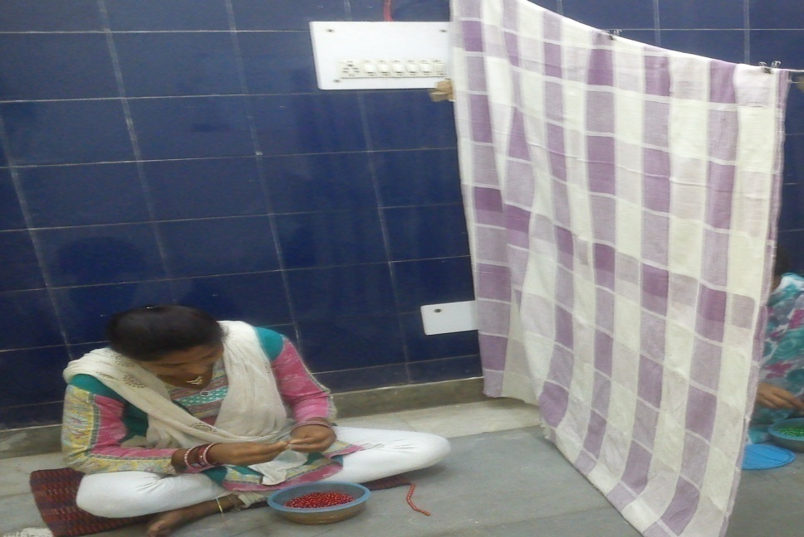
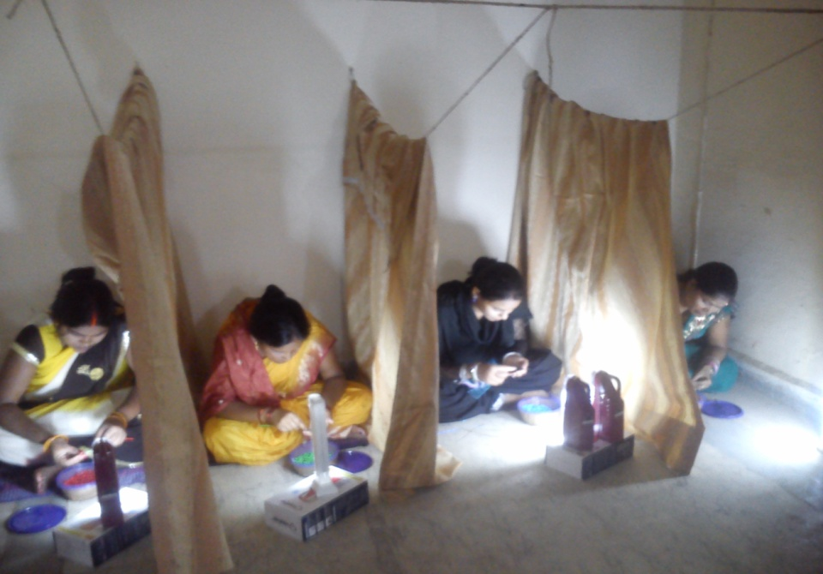

Slide 16
A finished bracelet

Slide 17
Experiment: Financial incentives
Number of bracelets produced by group | Subject payoff (Rs.)
 | Piece rate | Bonus
1 | 100 | 100
2 | 200 | 200
3 | 300 | 300
4 | 400 | 400
5 | 500 | 500 + 150 =650
6 | 600 | 600 + 150 =750
7 | 700 | 700 + 150 =850
…. | … | …
Note: Rs. 200 participation fee; 100% or more of the daily wage of a garment factory worker.
In bonus with loss framing the payment schedule was given to subjects in reverse order, i.e. starting with 7 or more bracelets
and moving down to 1 bracelet to produce a sense of ‘loss’ if they do not meet the threshold.

Slide 18
Data
Number of sessions |  |  |  |  |  | Number of Subjects
Incentive group | Homogeneous (Male) | Heterogeneous (Male) | Homogeneous (Female) | Heterogeneous (Female) | All
Piece Rate | 7 | 9 | 6 | 8 | 30 | 120
Bonus (Gains) | 13 | 12 | 12 | 14 | 51 | 204
Bonus (Loss) | 13 | 13 | 12 | 12 | 50 | 200
 | 33 | 34 | 30 | 34 | 131 | 524

Slide 19
Methodology
Y_{is} = α₀ + α₁ Socially Connected_{s} + α₂ X_{s} + α₃ Z_{i} +ϵ_{i}
Y_{is} = effort and co-ordination of subject i in session s
Socially Connected_{s} =1 if group members have same caste identity
X_{s} = dummy for piece rate or bonus framing
Z_{i} = age, caste category, marital status, religion, native state, employment status, education

Slide 20
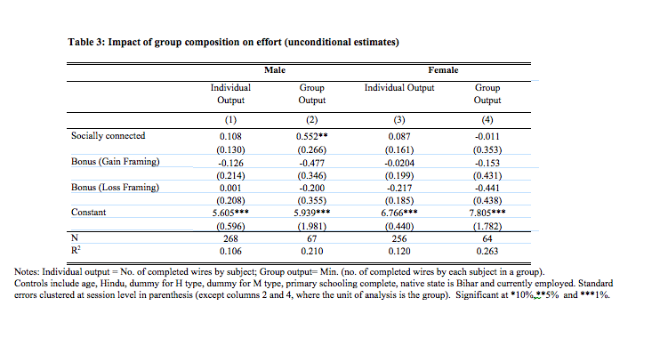

Slide 21
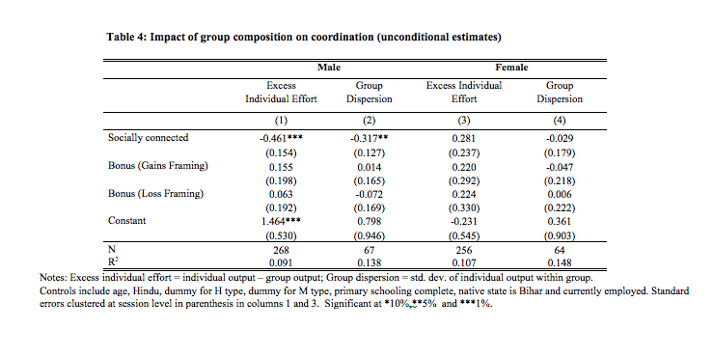

Slide 22
Low caste are most responsive to being in homogenous group, irrespective of gender
 | Individual Output | Payoff | Group Output | Excess Individual Effort | High Group Effort | Group Dispersion
 | (1) | (2) | (3) | (4) | (5) | (6)
Homogeneous | 0.461*** | 101.1** | 0.870*** | -0.409* | 0.050 | -0.234*
 | (0.175) | (39.04) | (0.221) | (0.208) | (0.145) | (0.123)
H | 0.093 | 14.66 | 0.115 | -0.0223 | 0.026 | -0.057
 | (0.216) | (14.83) | (0.131) | (0.201) | (0.034) | (0.067)
M | 0.319* | 16.59 | 0.126 | 0.194 | 0.021 | -0.011
 | (0.174) | (16.16) | (0.138) | (0.201) | (0.032) | (0.065)
H x Homogeneous | -0.406 | -41.86 | -0.599* | 0.193 | 0.037 | -0.002
 | (0.311) | (53.59) | (0.335) | (0.321) | (0.193) | (0.191)
M x Homogeneous | -0.504** | -109.0** | -0.903*** | 0.399 | -0.034 | 0.193
 | (0.214) | (45.73) | (0.298) | (0.282) | (0.154) | (0.150)
Constant | 5.404*** | 488.9*** | 4.192*** | 1.212*** | 0.384* | 0.795***
 | (0.336) | (72.61) | (0.482) | (0.442) | (0.220) | (0.195)
Homogeneous group effect on
L | 0.461*** | 101.1** | 0.870*** | -0.409* | 0.050 | -0.234*
 | (0.175) | (39.04) | (0.221) | (0.208) | (0.145) | (0.123)
M | -0.043 | -7.922 | -0.033 | -0.010 | 0.162 | -0.042
 | (0.139) | (30.968) | (0.238) | (0.202) | (0.082) | (0.108)
H | 0.054 | 59.203 | 0.271 | -0.216 | 0.088 | -0.236
 | (0.246) | (43.071) | (0.306) | (0.263) | (0.140) | (0.167)
N | 524 | 524 | 524 | 524 | 524 | 524
R² | 0.148 | 0.097 | 0.081 | 0.079 | 0.087 | 0.103
Notes: Controls include age, dummy for female, married, Hindu, primary schooling complete, native state is Bihar, and currently employed and type of financial incentive.
Standard errors clustered at session level in parenthesis. Significant at *10%, **5% and ***1%.

Slide 23
Interaction between social and financial incentives
Y_{is} = α₀ + α₁ Socially Connected_{s} + α₂ Bonus-Gain Framing_{s} + α₃ Bonus-Loss Framing_{s}
+ α₄ Socially Connected_{s} × Bonus-Gain Framing_{s}
+ α₅Socially Connected_{s} × Bonus-Loss Framing_{s} + α₆ X_{s} + α₇ Z_{i} + ϵ_{i}

Slide 24
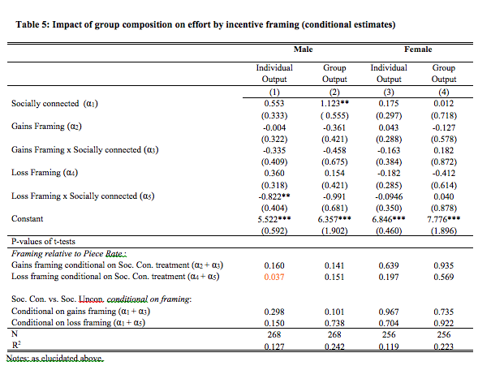

Slide 25
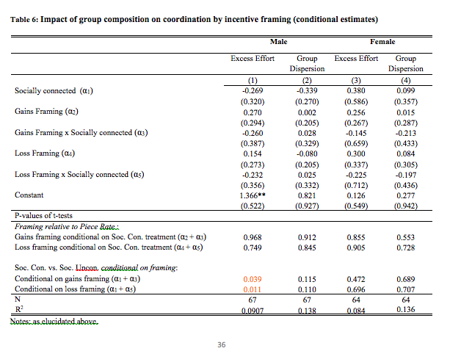

Slide 26
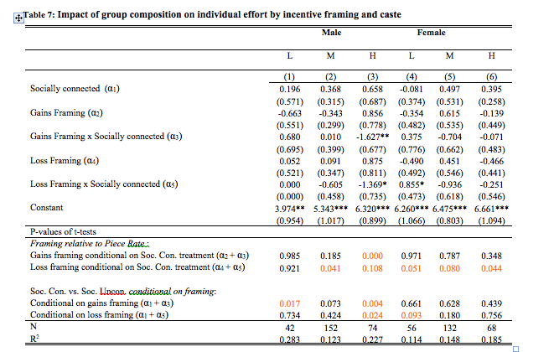

Slide 27
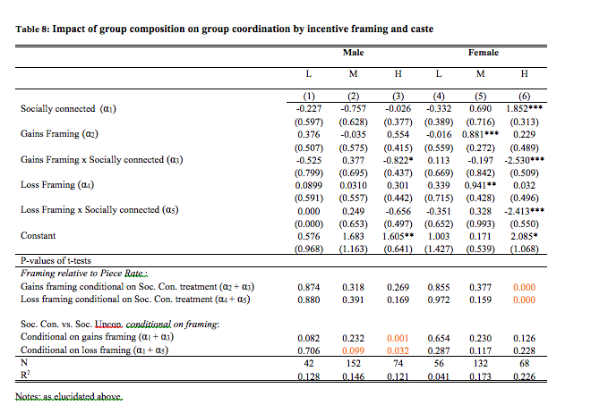

Slide 28
Summary
Males respond positively to being in-network through better within group co-ordination and higher group output.
Low caste males and females, together, show the strongest positive response to being in–group.
High powered incentives do not improve productivity over and above piece rates based on team performance. In some cases, loss framing reduces the productivity.

Slide 29
Summary
Interaction effects: Higher financial incentives help to improve coordination and reduce wasted effort for socially connected workers relative to unconnected workers, no significant effect on output (complementarity)
Especially for low and M type workers- a network effect that helps to reduce inequalities.
H caste coordinate better in the heterogenous group with higher powered incentives (substitutability).
Suggests that affinity is higher in the L groups relative to others.

Slide 30
Mechanisms?
(1) Taste based discrimination: altruism within caste encourages higher effort within a team. Experimental set up rules out peer pressure or inequity aversion.
Statistical Discrimination: expectations on ability differ across caste groups. More accurate perceptions within caste, together with self fulfilling beliefs on ability towards other castes.
(2) In our setting in addition there are multiple equilibria and maybe shared norms on effort helps to coordinate on the better equilibrium.

Slide 31
Conclusion
The organization of workers within a firm can have significant consequences for group productivity and inequality.
When production process requires coordination among workers, shared social identity can enhance group productivity due to altruism or beliefs on ability/effort and shared norms.
This has important implications for inequality, our results suggest that castes with deep affinity will benefit the most from this kind of homogeneity in team composition at the factory.

